Slide 1
Autmatisierung mit Azure Automation, Runbooks und Workflows
Oder auch ohne ☺
Holger Voges
Notes:
Todo: Beispielscripte
Parameter: https://azure.microsoft.com/en-us/documentation/articles/automation-starting-a-runbook/
Starten von Scripten
Webhooks
Zugriff auf Credentials
Hinzufügen von Modulen
Clients registrieren
Hybride Konfiguration (Hybrid Worker Gruppe)
Integration der Quellcodeverwaltung
Webhooks

Slide 2

About_Author
Holger Voges
CCA,MCSE, MCDBA, MCT, MCITP DB Administrator / DB Developer, MCTIP Enterprise Administrator
Netz-Weise Freundallee 13a 30173 Hannover www.netz-weise.de

Slide 3
Agenda
(OWS) Azure Automation für die Cloud - und zu Hause
Einrichten eines Automation Kontos
Erstellen von Runbooks
Der Runbook Designer
Scripte
Workflows
Hybrid Runbook Worker
Azure Automation DSC konfigurieren

Slide 4
Einrichten eines Automation-Accounts
Container für Runbooks,Assets und DSC
Beinhaltet
Berechtigungen
Runbooks
Credentials
Zeitpläne
DSC-Konfigurationen
Reports

Slide 5
Runbooks
Runbooks = Powershell Scripte und Workflows
Runbooktypen:
Workflow
Powershell-Script (neu!)
Grafische Runbooks (neu!)
Grafische Runbooks = Workflows

Slide 6
Ein Powershell Workflow
Parellisierbar
Robust durch Checkpoints
Übersteht Reboots
Basiert auf Workflows, nicht Powershell
Laaaannnngsaaaam...

Slide 7
Demo
Einrichtung im Azure-Portal

Slide 8
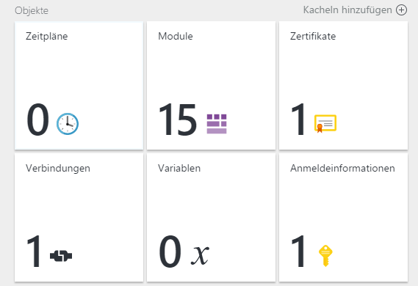
Assets (Objeke)

Slide 9
Starten von Runbooks
Manuell im Portal
Per Schedule (im Portal)
Per Script
Per Webhook (aus einer Anwendung heraus)
Per Azure Alert

Slide 10
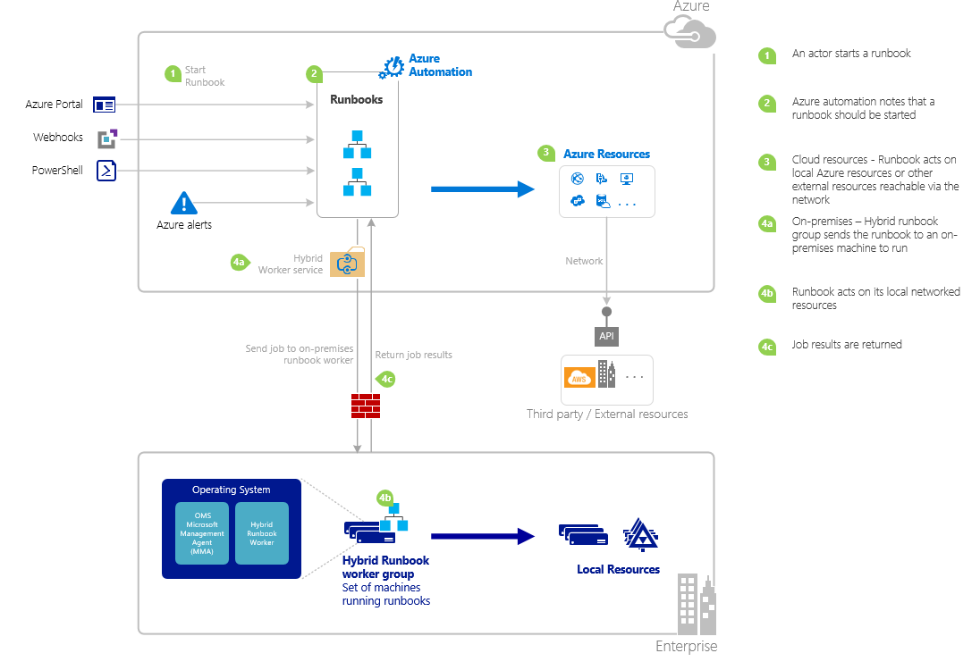
Starten von Runbooks

Slide 11
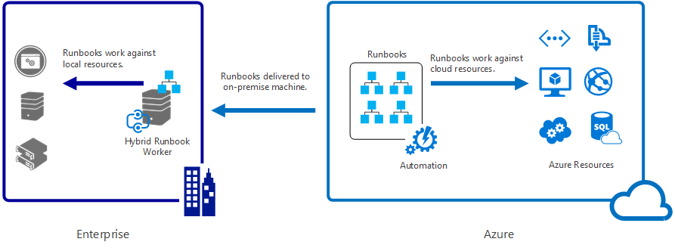
Hybrid Runbook Worker

Slide 12
Hybrid Runbook Worker Einrichtung
Skalierbar
Benötigen OMS-Client
Werden per Powershell aktiviert
Runbook-Worker werden Gruppen zugeordnet
Runbooks können in Azure oder auf einer Runbook-Worker Gruppe ausgeführt werden
Einer Worker-Group kann ein RunAS-Konto zugewiesen werden
Notes:
C:\ProgramData\Microsoft\System Center\Orchestrator\7.2\SMA\Sandboxes.

Slide 13
Automation DSC
Azure kann als DSC-Pull-Server agieren
DSC-Nodes werden per meta.mof bereitgestellt
Konfiguration benötigt nur einen Endpunkt und einen Key!
Konfigurationen können flexibel an Knoten verteilt werden
DSC-Automation enthält Reporting!
Benötigt WMF 5.0 auf dem Node

Slide 14
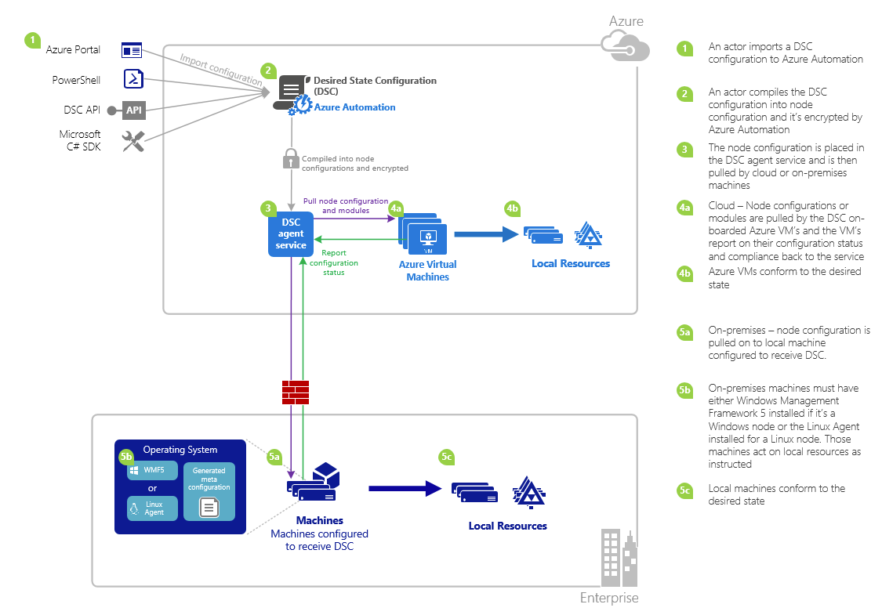
Automation DSC Übersicht
Notes:
Gotchas / Known Issues:
When upgrading to WMF 5 RTM, if the machine is already registered as a node in Azure Automation DSC, please unregister it from Azure Automation DSC and reregister it after the WMF 5 RTM upgrade.
Azure Automation DSC does not support partial or composite DSC configurations at this time. However, DSC composite resources can be imported and used just like in local PowerShell, enabling configuration reuse.
The latest version of WMF 5 must be installed for the PowerShell DSC agent for Windows to be able to communicate with Azure Automation. The latest version of the PowerShell DSC agent for Linux must be installed for Linux to be able to communicate with Azure Automation.
The traditional PowerShell DSC pull server expects module zips to be placed on the pull server in the format ModuleName_Version.zip”. Azure Automation expects PowerShell modules to be imported with names in the form of ModuleName.zip. See this blog post for more info on the Integration Module format needed to import the module into Azure Automation.
PowerShell modules imported into Azure Automation cannot contain .doc or .docx files. Some PowerShell modules containing DSC resources contain these files, for help purposes. These files should be removed from modules, prior to import into Azure Automation.
When a node is first registered with an Azure Automation account, or the node is changed to be mapped to a different node configuration server-side, it’s status will be 'Compliant', even if the node’s status is not actually compliant with the node configuration it is now mapped to. After the node performs its first pull, and sends its first report, after registration or a node configuration mapping change, the node status can be trusted.
When onboarding an Azure Windows VM for management by Azure Automation DSC using any of our direct onboarding methods, it could take up to an hour for the VM to show up as a DSC node in Azure Automation. This is due to the installation of Windows Management Framework 5.0 on the VM by the Azure VM DSC extension, which is required to onboard the VM to Azure Automation DSC.
After registering, each node automatically negotiates a unique certificate for authentication that expires after one year. At this time, the PowerShell DSC registration protocol cannot automatically renew certificates when they are nearing expiration, so you need to reregister the nodes after a year’s time. Before reregistering, ensure that each node is running Windows Management Framework 5.0 RTM. If a node’s authentication certificate expires, and the node is not reregistered, the node will be unable to communicate with Azure Automation and will be marked ‘Unresponsive.’ Reregistration is performed in the same way you registered the node initially. Reregistration performed 90 days or less from the certificate expiration time, or at any point after the certificate expiration time, will result in a new certificate being generated and used.
When upgrading to WMF 5 RTM, if the machine is already registered as a node in Azure Automation DSC, please unregister it from Azure Automation DSC and reregister it after the WMF 5 RTM upgrade. Before reregistering, delete the $env:windir\system32\configuration\DSCEngineCache.mof file.
PowerShell DSC cmdlets may not work if WMF 5 RTM is installed on top of WMF 5 Production Preview. To fix this, run the following command in an elevated PowerShell session (run as administrator): mofcomp $env:windir\system32\wbem\DscCoreConfProv.mof

Slide 15
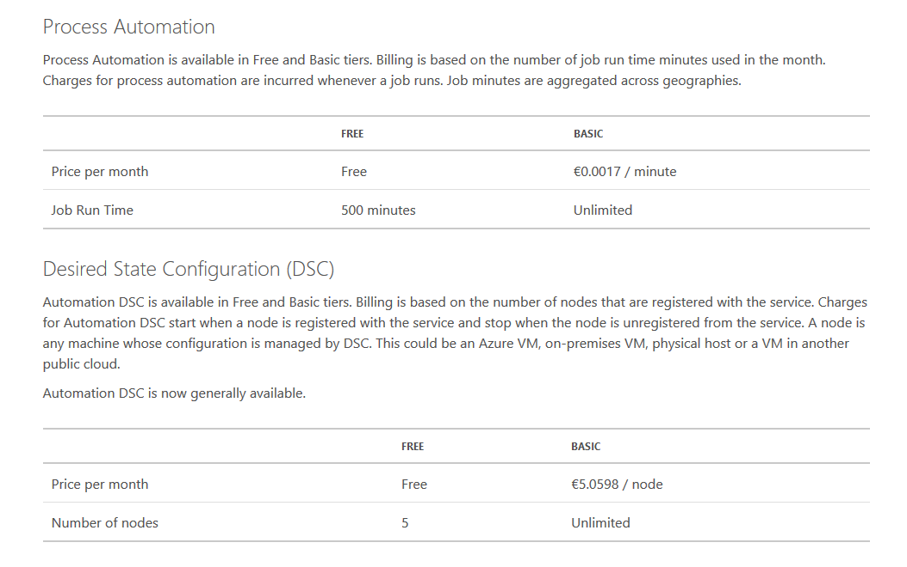
Get-Price

Slide 16
Workflows

Slide 17
Summary
Azure Automation benötigt keine Workflows mehr
Mit OMS Azure-Automation können auch On-Premise-Server automatisiert werden
Azure Automation kann den DSC-Pull-Server ersetzen
Mit WMF 5.0 wird Azure zur Reporting-Plattform für DSC

Slide 18
Get-Question

